Slide 1
Interior of the earth
          INTRODUCTION-
          However the study of constitution of the interior of the earth is out side the domain of Geography, but its elementary knowledge is necessary for the geographers because the nature and configuration of the reliefs of the earth surface largely depend on the nature, mechanism and magnitude of the endogentic forces which originate from within the earth.
It is very difficult task to have accurate knowledge of the constitution of the earth’s interior because it is beyond the range of direct observation by man, but recently seismology has helped to have some authenticated knowledge about the mystery of earth interior.

Slide 2
The sources which provide knowledge about the interior of the earth may be classified into three groups.
SOURCES
Evidence from the theories of the origin of the earth
Density
Pressure
Natural sources
Like volcanic eruption
Artificial sources
Temperature
Earthquake and seismology

Slide 3
Artificial fact
Numerous inferences can be drawn about the constitution of the interior of the earth on the basis of density of rocks, pressure of superincumbent load (lying on some thing else) and increasing trend of temperature with increasing depth inside the earth. It is commonly believed that the outer thinner part of the earth is composed of sedimentary rocks the thickness of which ranges between 0.8 km to 1.6 km.
Just below this sedimentary layer there is the second layer of crystalline rocks, the density of which ranges between 3.0 and 3.5 at different places.
The average density of the whole earth is about 5.5. Thus it appears that the density of the core of the earth will be, without doubt, more than 5.5.
The satellite studies have revealed the following results about the density of various parts of the earth-average density of the earth= 5.517 g cm-3 , average density of the earth’s surface=2.6 to 3.3g cm-3 and average density of the core=11g cm-3.

Slide 4
Pressure
Pressure is the force applied perpendicular to the surface of an object per unit area over which that force is distributed. The standard unit of pressure is the pascal.
Now question arises, what is the reason for very high density of the core? Previously it was believed that very high density of the core was because of heavy pressure of overlaying rocks. It is the common principle that pressure increases the density of rocks.
Since the weight and pressure of rocks increase with increasing depth and hence the density of rocks also increasing with increasing depth.
Some other evidence proved that the core must be composed of intrinsically heavy metallic materials of high density.
The experiments have revealed that the core of the earth is made of the mixture of iron and nickel.

Slide 5
TEMERATURE
It is evident on the basis of information available from the findings of bore holes and deep mining that temperature increases from the surface of the earth downward at the rate of 2° to 3°C for 100 meters.
Temperature increase from the surface of the earth downward at the rate of 1°C for 32 meters.
It may be pointed out that it becomes very difficult to find out the rate of increase of temperature beyond the depth of 8 km.

Slide 6
Evidence from the theories of the origin of the earth
Various exponents of different hypotheses and theories of the origin of the earth have assumed the original form of the earth to be solid or liquid or gaseous.
According to the ‘Planetesimal hypothesis’ the earth was originated due to aggregation of solid dust particles. The core of the earth should be in solid state.
According to ‘tidal hypothesis’ the core of the earth should be in liquid state because the earth has been taken to have been formed.
According to the ‘Nebular hypothesis’ of Laplace the core of the earth should be in liquid state.

Slide 7
NATURAL SOURCES
Volcanic eruption
Some scientists believe on the basis of upwelling and spread of hot and liquid lava on the earth’s surface during the volcanic eruption that at least such a layer below the earth’s surface which is in liquid state.
Such molten layer has been termed as ‘magma chamber’ which supplies magma and lava during volcanic eruptions.
It may be, surmised, on the basis of above connotation, that some part of the earth should be in liquid state.
It, thus appears that the earth core should be in solid state. Now question arises, where hot and liquid lava come from during the volcanic eruption?

Slide 8
Evidences of seismology (Earthquake)
Seismology is the science which studies various aspects of seismic wave generated during the occurrence of earthquakes. Seismic waves are recorded with the help of an instrument known as seismograph.
It may be pointed out that seismology is the only source which provides us authenticated information about the composition of earth’s interior.
The place of the occurrence of an earthquake is called ‘Focus’ and the place which experiences the seismic event first is called ‘epicentre’ which is located on the earth surface and is always perpendicular to the ‘focus’.

Slide 9
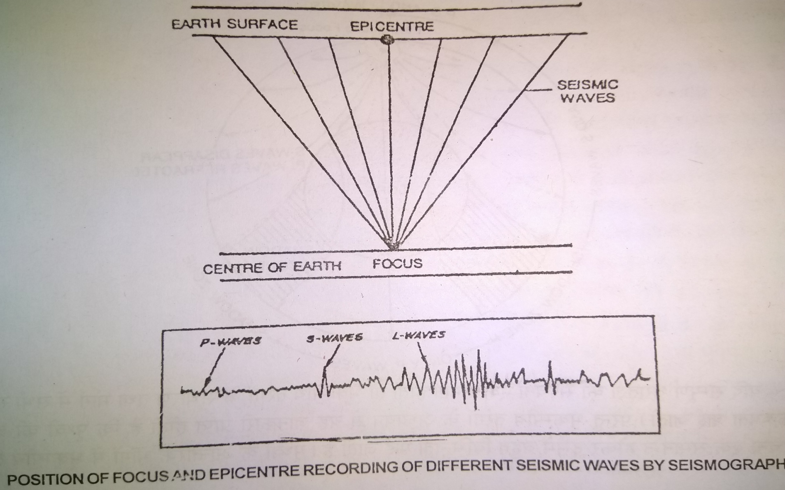
Earthquake process

Slide 10
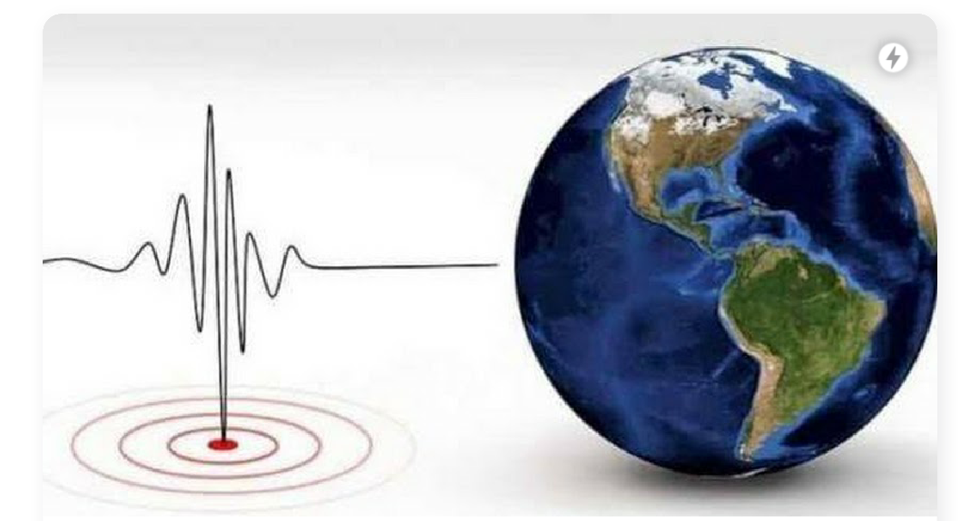
Earthquake

Slide 11
On the other hand , the focus or the place of the origin of an earthquake is always inside the earth.
The deepest focus has been measured at the depth of 700 km from the earth surface
The different type of tremors and waves generated during the occurrence of an earthquake are called ‘seismic waves’ which are generally divided into three broad categories.
Like-1) Primary waves
2) Secondary waves
3) Surface waves

Slide 12
Types of waves and their work
Primary waves also called as longitudinal or compressional wave or simply ‘P’ waves, are analogous to sound wave wherein particles move both to and fro in the line of the propagation of the ray. P waves travel with fastest speed through solid materials. These also pass through liquid materials but their speed is slowed down.
Secondary waves are also called as transverse or distortional or simply S waves. S waves can not pass through liquid materials.
Surface waves are also called as long period waves or simply L waves. These waves generally affected only the earth surface of the earth. These waves cover longest distance of all the seismic waves. However their speed is lower than P and S waves what these are most violent and destructive

Slide 13
However the nature and properties of the composition of the interior of the earth may be successfully obtained on the basis of the study of various aspects of seismic waves.
Mainly the velocity and travel paths of these waves while passing through a homogeneous solid body but these waves are reflected and refracted (to make a ray of light change direction when it goes through at an angle) while passing through a body having heterogenous composition and varying density zones.
If the earth would have been composed of homogenous solid material the seismic waves should have reached the core of the earth in a straight path but this is not the case in reality.
In fact , the recorded seismic waves denote the fact that these waves seldom follow straight paths rather they adopt curved and refracted paths. Thus it become obvious that the earth is not composed of homogenous materials rather there are variations of density inside the earth.

Slide 14
It is a known fact that the velocity of seismic waves changes only when there are changes in the density of rocks.
On the basis of velocity seismic waves are divided into three sets of waves. 1) First set of P-S waves of maximum velocity,
2) Second set of Pg-Sg waves of minimum velocity
3) Third set of P*-S* waves of medium velocity falling between the first and the second set of waves.

